Slide 1

Customer Analytics
CrossR Tutorial
March 19, 2019

Slide 2
Motivation
CrossR Tour
CrossR Session
2

Slide 3
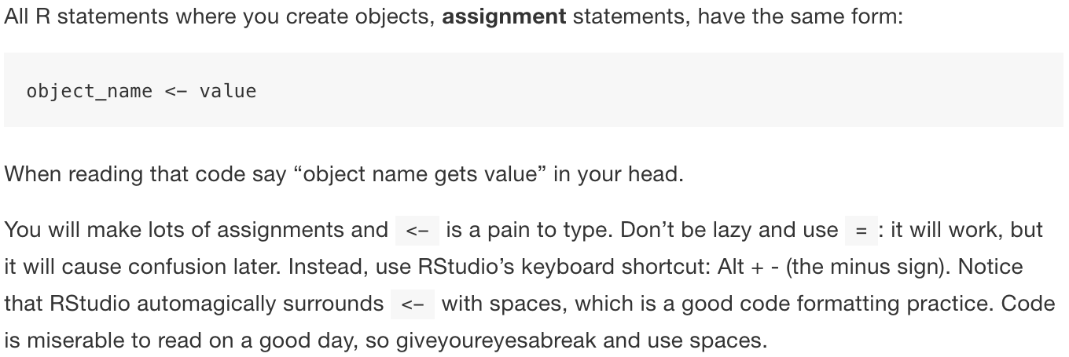
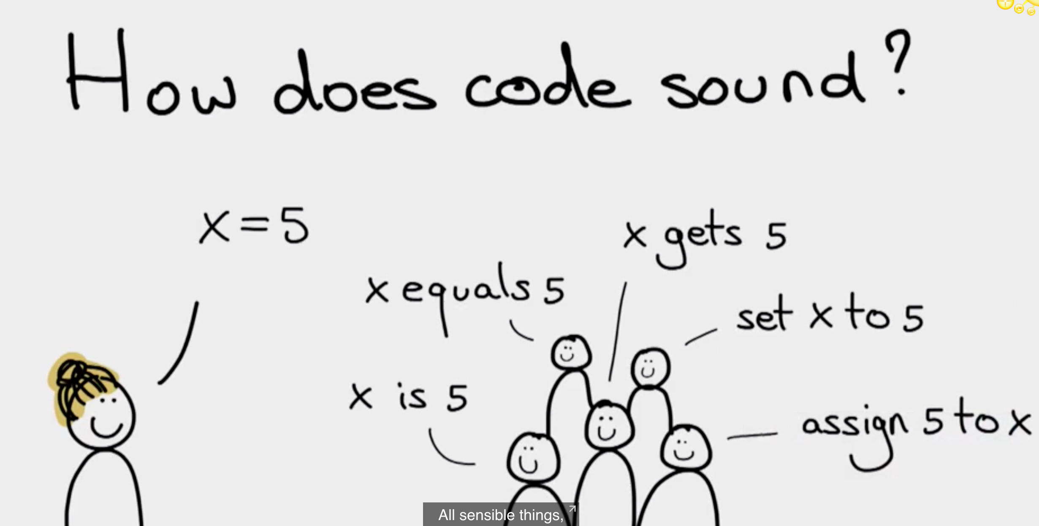
https://resources.rstudio.com/rstudio-conf-2019/opening-keynote-day2
Garrett Grolemund
Hadley Wickham
R for Data Science
https://r4ds.had.co.nz/workflow-basics.html#coding-basics
3
Notes:
We need consistent vocalization for source code.

Slide 4
We need consistent vocalization for source code.
Felienne, Assistant Professor at Delft University of Technology
http://www.felienne.com
4
Notes:
w/Master - KK

Slide 5
CrossFit
https://www.flickr.com/photos/esthermax/30239358420
Essentials.
Daily workouts (aka "WODs" or "workouts of the day")
Constantly varied
Functional movements (movements you make every day)
Done at high intensity
Scientifically-backed, evidence-based approach
Small-group, semi-private lessons from certified trainers
Notes:
w/Master - KK

Slide 6
CrossR
Essentials.
Daily sessions (aka ”SODs" or ”sessions of the day")
Constantly varied
Functional movements that require limited cognitive load
Done at high intensity
Scientifically-backed, evidence-based approach
Small-group, semi-private lessons from certified trainers
Notes:
w/Master - KK

Slide 7
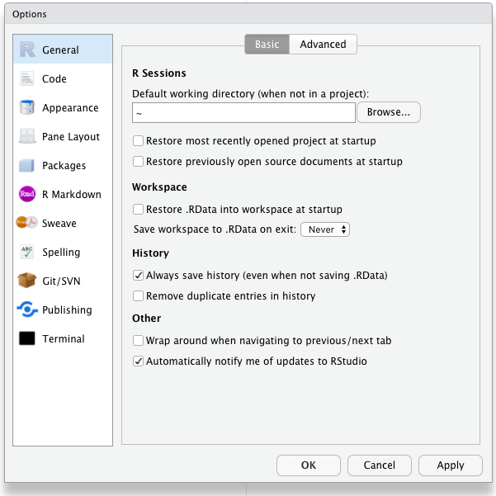
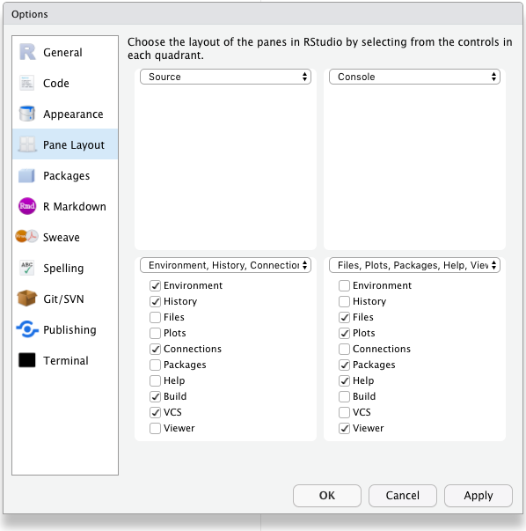
CrossR Tour
Tools > Global Options / ⌘ + ,
Source: https://whattheyforgot.org/save-source.html#always-start-r-with-a-blank-slate usethis::use_blank_slate()

